Slide 1
Sentence classification
Sentiment and stance detection, transfer learning, bias and error in annotations

Slide 2
Sentiment analysis

Slide 3

Sentiment analysis
Automated sentiment analysis is a core task in NLP, and is concerned with classifying or scaling a document according to its general polarity on a positive–negative scale
(Bestvater & Munroe 2022)

Slide 4
Sentiment analysis
Sometimes hand-annotated by author
Ex. movie review + "rotten" or "fresh" rating
Ex. product review + star rating
Often hand-annotated by human coders
Ex. social media posts
Ex. financial news headlines
Ex. political campaign ads
Notes:
SoMe: to measure a national "mood" (and figure out its predictors), or sentiment around a topic
Finance: to predict the stock market
Ads: to see which candidates go negative ("mudslinging, fearmongering") with their messages and when

Slide 5
Sentiment analysis
Sentiment hand-coding challenges:
Sarcasm: "I guess I'm glad that it has an off button"
Context knowledge: "this place is no better than Bertucci's"
Mixed sentiment: "I love it but it's just too expensive"
a.k.a. multipolarity

Slide 6
Sentiment analysis
Sentiment prediction challenges: al of the above plus
Negative modifiers: "I don't like it"
No sentiment-laden words: "I just can't put this book down"
Context-dependent word polarity:
"I feel bad for anyone who likes this shirt" vs.
"I feel so bad ass when I wear this shirt"
"The battery life is long" vs.
"The customer service wait time is long"

Slide 7
Sentiment analysis
Sentiment analysis models
Historically: dictionary methods (e.g. LIWC)
Then: pretty much all the models we have talked about
Pre-trained, fine-tuned transformers like BERT are state of the art
Notes:
Dictionary methods: just counting the number of positive v. negative words. The more advanced models that we've seen can deal with many of the problems we just mentioned. RNNs and LSTMs can deal with negatives, because they remember that we recently encountered a word like "not" or "don't". Models with self-attention, like transformers, can pick up on context-dependent meaning of word by noticing whether "bad" is being used in "feel bad" or "bad ass".

Slide 8
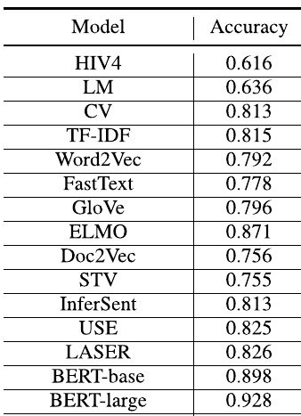
Sentiment dictionaries for finance
Pre-trained word embeddings
Mishev et al. (2020),
Evaluation of Sentiment Analysis in Finance:
From Lexicons to Transformers
Pre-trained BERT
Notes:
Training and test data are snippets of financial news and finance-related microblogs, hand-coded by experts

Slide 9
Sentiment analysis
Liu et al. (2021)
Sentiment analysis models
Few-shot context-specific sentiment analysis with GPT-3
Ex. Classify the sentiment of a movie review given these examples:
"contains no wit, only labored gags": negative
"puts a smile on your face": positive
"nothing but boilerplate clichés from start to finish": negative
Notes:
So all we need is a set of labeled examples that come from a similar context as our current test snippet. So, if we want to use few-shot learning with GPT-3 for movie reviews, we need a (possibly very small) dataset of labeled movie reviews. I'm about to show you results from a paper where they tried to get GPT-3 to do sentiment analysis on movie reviews from the IMDB database, using examples from another movie review database (SST-2). This is to mimic the set-up where you might use this approach: you want to classify snippets from one context, and you have a labeled dataset collected in a similar but not identical context.

Slide 10
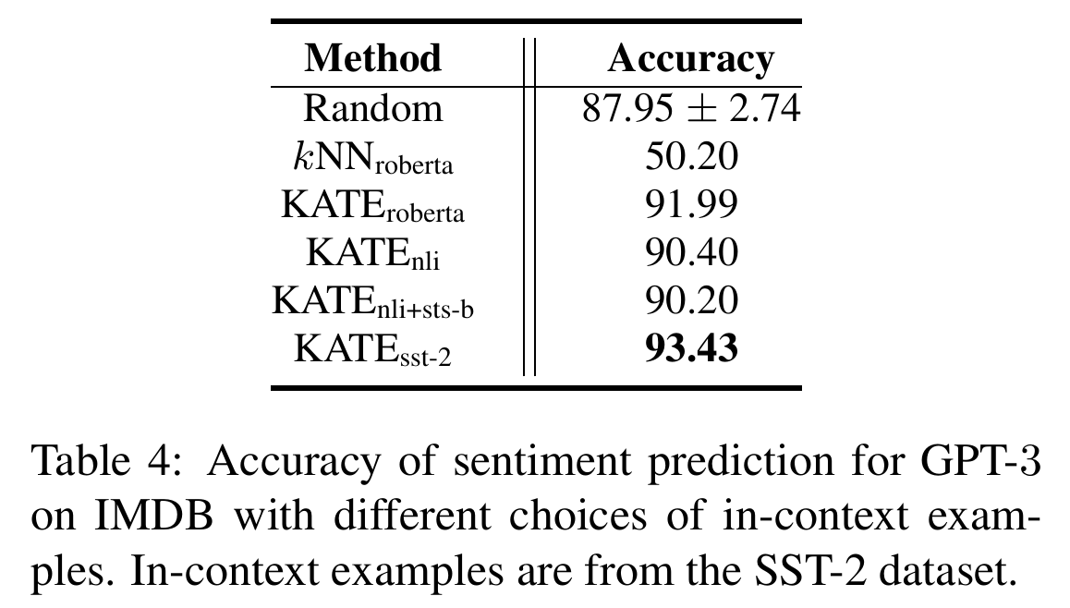
Liu et al. (2021)
Notes:
These results show that, if you just pull random examples (from the same context), the few-shot performance of GPT-3 is good but somewhat variable. If you go about carefully selecting the examples to be similar to the test snippet—so if we find those labeled movie reviews in our same-context dataset that look a lot like the review we want to classify now, then GPT-3 can perform really well. For reference, a BERT model that is actually fine-tuned on this same IMDB sentiment task performs at 96%--this is a model that has seen 25.000 examples instead of three. https://paperswithcode.com/sota/sentiment-analysis-on-imdb

Slide 11
Sentiment is not stance

Slide 12
Sentiment is not stance
Sentiment analysis is sometimes used to measure "tone" around a topic (over time or by different speakers)
But consider:
"I am terrified of climate change"
"I am terrified of climate alarmism"
Same topic, same tone, opposite targets
Notes:
In fact, sentiment analysis has sometimes been called "opinion mining"

Slide 13
Sentiment analysis
stance detection is [...] automatic classification of the stance of the producer of a piece of text, towards a target, into one of these three classes: {Favor, Against, Neither}
(Küçük & Can, 2020)
Notes:
Stance becomes different from sentiment when documents on the same topic could have very different opinion targets. This is less of an issue with product or movie reviews: the target of sentiments expressed in those is almost always the product or the movie (except occasionally, e.g. in "some people say this movie is the best; they are wrong")

Slide 14
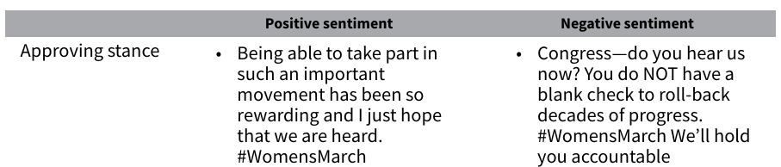
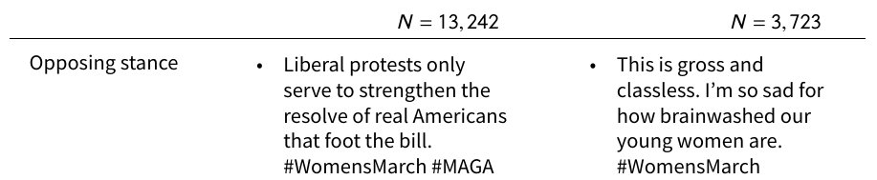
(Bestvater & Munroe 2022)
Notes:
Tweets rated by human coders. Sentiment in US open-ended survey questions that mention Trump are only correlated at .51 with stances towards Trump. In tweets about the Brett Kavanaugh confirmation hearing, sentiment and stance towards Kavanaugh are uncorrelated. Takeaway: if you are going to train a model on human-coded sentiment, don't expect it to capture stance.

Slide 15
Sentiment is not stance
Some new methods for stance detection:
Structured sentiment analysis
Fine-tuning transformers
on a human-coded dataset about the stance(s) of interest

Slide 16
Sentiment is not stance
Barnes et al. (2022)
Structured Sentiment Analysis
"Each opinion O_{i} is a tuple (h, t, e, p), where h is a holder who expresses a polarity p towards a target t through a sentiment expression e."

Slide 17
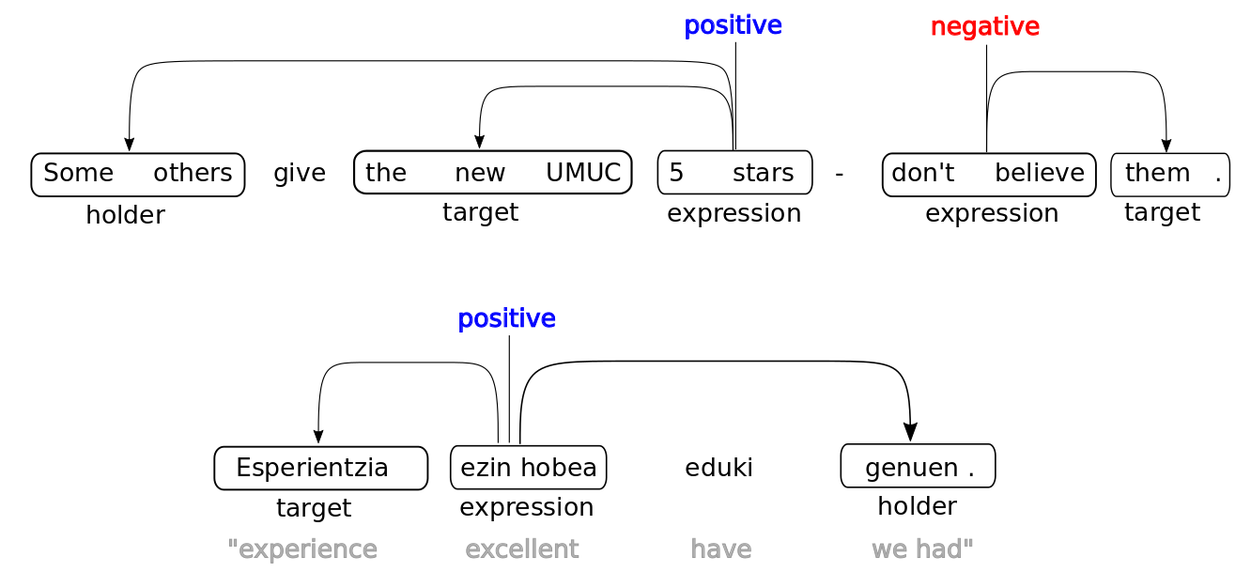

Slide 18
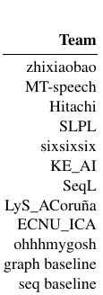

Barnes et al. (2022)
Metric:
sentiment graph F1
Notes:
Metric is an adjusted F1, that takes into account the fact that labeling just “UMUC” as the target instead of “the new UMUC” is not a very big mistake. In other words, this task is still hard.

Slide 19
Course evaluation
evaluering.ku.dk

Slide 20
Transfer learning

Slide 21
Transfer learning
Learning one task in a domain with lots of data
Using weights to learn a related task in another domain with less data
Three types:
Feature extraction
Fine-tuning
Pre-trained weights as initializations only
Notes:
This is very common in social science applications, because we often have smaller datasets than our computer science counterparts

Slide 22
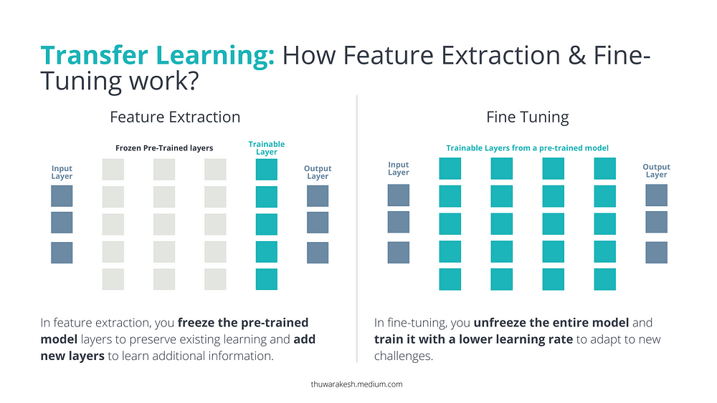
Notes:
Feature extraction: all parameters from pre-trained model frozen; only add one or multiple layers on top ("head layers")
Fine-tuning: adding head layer(s) and allowing earlier parameters to change as well (typically with a low learning rate). Perhaps only the later layers; perhaps the whole model.
Pre-trained initialization: all parameters free, high learning rate; weights in the model are just set to weights from another pre-trained version of the model, rather than to zeroes or random numbers. Helps with convergence (only).
https://towardsdatascience.com/transfer-learning-in-deep-learning-641089950f5d

Slide 23
Transfer learning
You already know one feature extraction approach:
Pre-trained word embeddings
word2vec (or FastText or GloVe or BERT) model learned how to turn words into useful feature vectors
Turn our words into feature vectors using these models
Use those features as supervised model inputs
Notes:
Looking back at the previous slide, we can see that using pre-trained word embeddings is exactly what feature extraction is: we trained a model; that model learned weights for an embedding layer and an output layer; we are not interested in the output layer because we are not trying to predict target words from context words; instead we only feed our inputs through that first, embedding layer of the model; that produces word embeddings; and those embeddings can then be used in our model, for example a sentiment analysis RNN.

Slide 24
Transfer learning
Examples:
Political text classification (Terechshenko 2020)
Deepmoji (Felbo et al. 2017)
Fine-tuning transformers for stance detection (Slovikovskaya 2019)

Slide 25
Transfer learning
Political text classification (Terechshenko 2020)
Four political classification tasks:
380,000 legislative bills, topic detection
27,000 NYT headlines, topic detection
2,500 tweets about Hillary Clinton, sentiment detection (+/-/0)
43,000 Wikipedia comments, hate speech detection (yes/no)

Slide 26
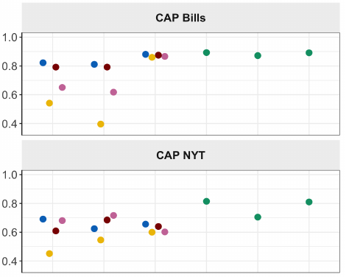
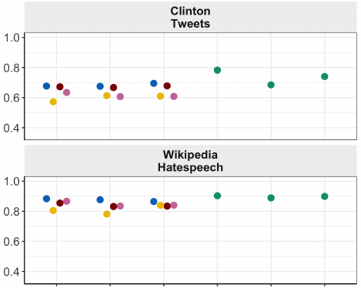
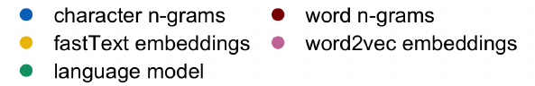
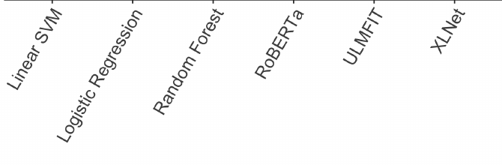
Notes:
On these four very different tasks, with very different amounts of in-domain data that the models could be trained on, we see that fine-tuned transformers score best across the board. Word embeddings do quite a lot worse on the topic tasks with many outcome classes.

Slide 27
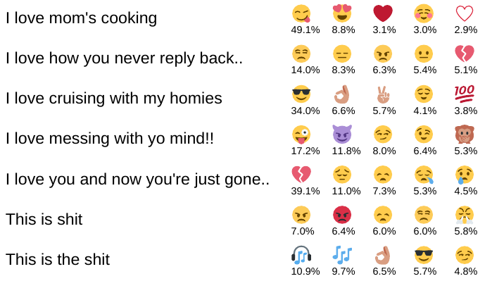
Transfer learning
Deepmoji (Felbo et al. 2017)
Original task:
Emoji prediction on 1.2B tweets
Notes:
The model learns to do this: given the text of a tweet, guess which of 64 possible emojis were in it. This is pretty useful in its own right, because emojis are an expression of sentiment. So this is a tweet sentiment analysis model trained on a massive dataset—that’s nice. And as you can, it’s giving very reasonable predicitons. But the real power lies in using it for transfer learning.

Slide 28
Transfer learning
Deepmoji (Felbo et al. 2017)
Transfer tasks:
Sentiment detection on Twitter
Sentiment detection on YouTube
Emotion detection on headlines, tweets, personal stories
Sarcasm detection on debate forum posts
Notes:
The model learns to do this: given the text of a tweet, guess which of 64 possible emojis were in it. This is pretty useful in its own right, because emojis are an expression of sentiment. So this is a tweet sentiment analysis model trained on a massive dataset—that’s nice. And as you can, it’s giving very reasonable predicitons. But the real power lies in using it for transfer learning.

Slide 29
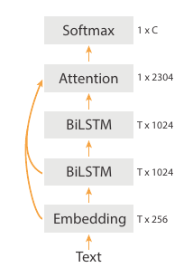
Transfer learning
Feature extraction:
Train a bi-directional deep LSTM on the tweet emoji task
Notes:
Note: this paper was pre-transformers. So BiLSTM with an attention layer was state-of-the-art (this is not query-key-value attention, because that was invented as part of the transformer architecture, but another type of attention mechanism).

Slide 30
Transfer learning
Feature extraction:
Train a bi-directional deep LSTM on the tweet emoji task
Throw away the output layer

Slide 31
Transfer learning
Feature extraction:
Train a bi-directional deep LSTM on the tweet emoji task
Throw away the output layer
Add a new output layer and train it on the new task (freeze rest of model)
Notes:
Note: this paper was pre-transformers. So BiLSTM with an attention layer was state-of-the-art (this is not query-key-value attention, because that was invented as part of the transformer architecture, but another type of attention mechanism).

Slide 32
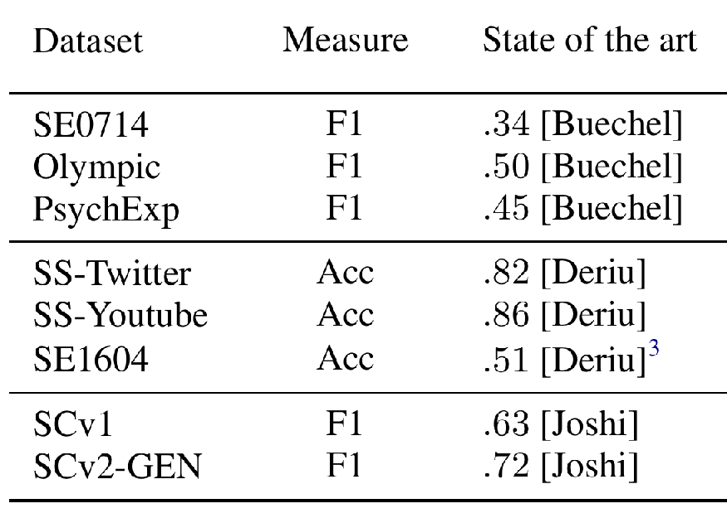
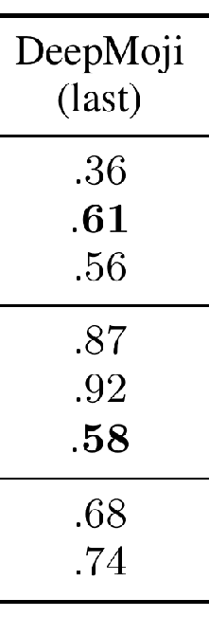
Notes:
State-of-the-art shows that some of these are quite difficult tasks (first are emotion detection, second sentiment detection and third sarcasm detection)

Slide 33
Transfer learning
“chain-thaw” approach to fine-tuning:
Train a bi-directional deep LSTM on the tweet emoji task

Slide 34
Transfer learning
“chain-thaw” approach to fine-tuning:
Train a bi-directional deep LSTM on the tweet emoji task
Throw away the output layer
Notes:
Note: it is actually unclear from the paper if and when the attention layer gets finetuned

Slide 35
Transfer learning
“chain-thaw” approach to fine-tuning:
Train a bi-directional deep LSTM on the tweet emoji task
Throw away the output layer
Add a new output layer and train it on the new task (freeze rest of model)

Slide 36
Transfer learning
“chain-thaw” approach to fine-tuning:
Train a bi-directional deep LSTM on the tweet emoji task
Throw away the output layer
Add a new output layer and train it on the new task
Fine-tune BiLSTM 1 (freeze everything else)

Slide 37
Transfer learning
“chain-thaw” approach to fine-tuning:
Train a bi-directional deep LSTM on the tweet emoji task
Throw away the output layer
Add a new output layer and train it on the new task
Fine-tune BiLSTM 1
Fine-tune BiLSTM 2 (freeze everything else)

Slide 38
Transfer learning
“chain-thaw” approach to fine-tuning:
Train a bi-directional deep LSTM on the tweet emoji task
Throw away the output layer
Add a new output layer and train it on the new task
Fine-tune BiLSTM 1
Fine-tune BiLSTM 2
Fine-tune full model

Slide 39
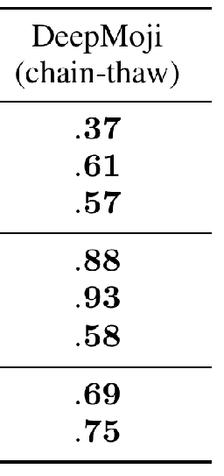
Notes:
State-of-the-art shows that some of these are quite difficult tasks (first are emotion detection, second sentiment detection and third sarcasm detection)

Slide 40
Sentiment is not stance
Fine-tuning transformers for stance detection (Slovikovskaya 2019)
Does a news snippet agree or disagree with a given claim, or neither? (FNC-1 task)
Snippet: Led Zeppelin’s Robert Plant turned down £500 MILLION to reform supergroup
Claim: Robert Plant Ripped up $800M Led Zeppelin Reunion Contract
Notes:
Purpose is fake news detection: we want to be able to give the model a new snippet and a claim that we know is wrong, and automatically flag if the snippet supports the false claim.

Slide 41
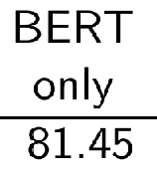
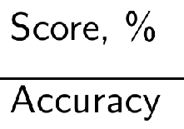
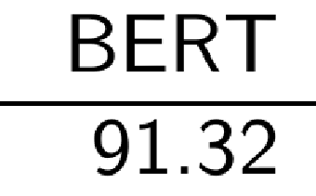
Feature extraction*
Fine-tuning
* fed into six-layer-deep neural net
Notes:
So if we only feed the snippets to BERT, and use the final encoders’ output from BERT as input for a deep neural net, we already get very good performance. But if we fine-tune the whole BERT model, just replacing its final layer with a layer that tries to get the agreement status of the snippet with the claim, we get even better performance.

Slide 42
Bias and error in annotations
Notes:
So far, we’ve been treating human-coded annotations as so-called “gold” labels; they encode the ground truth.

Slide 43
Bias and error in annotations
A stupid example: named entity recognition
Named entity = a person, organization, geo-political entity, location or facility, referred to by a proper name
(Automatic Content Extraction English Annotation Guidelines for Entities, 2008)
Notes:
You can already tell it’s bad news when a project with this long of a name is created to define this simple-seeming of a task. Don’t look ahead in the slides right now, because I want to play a little NER game with you.

Slide 44
Bias and error in annotations
Is God a person?
Is Harry Potter a person?
Is HAL a person?
Is an Airbus A310 a facility?
In “things aren’t going well for Liverpool”, is Liverpool a location or an organization?
In “Hear, O Israel, the Lord our God, the Lord is one”, is Israel a person, location or organization?
Notes:
Israel example is from Ratinov & Roth (2009). Q: what are some social science concepts that you would expect are more difficult to code than named entities?

Slide 45
Bias and error in annotations
Social science concepts are much trickier than named entities:
Hate speech
Misogyny/racism/transphobia/antisemitism
Misinformation/disinformation
Ideology
Personality traits
…

Slide 46
Bias and error in annotations
How are
climate / gun policy / immigration
framed on US talk radio, before and after
a hurricane / a shooting / family separation?
(Vandeweerdt 2023)

Slide 47
Bias and error in annotations
Isolate 30-second fragments around each mention of a topic keyword
Two MTurkers picked a frame for each one (or neither frame)
Climate change: convinced v. skeptical
Gun control: anti-gun v. pro-gun
Immigration: tough on immigration v. supportive of immigration
If they disagree, asked a third coder

Slide 48
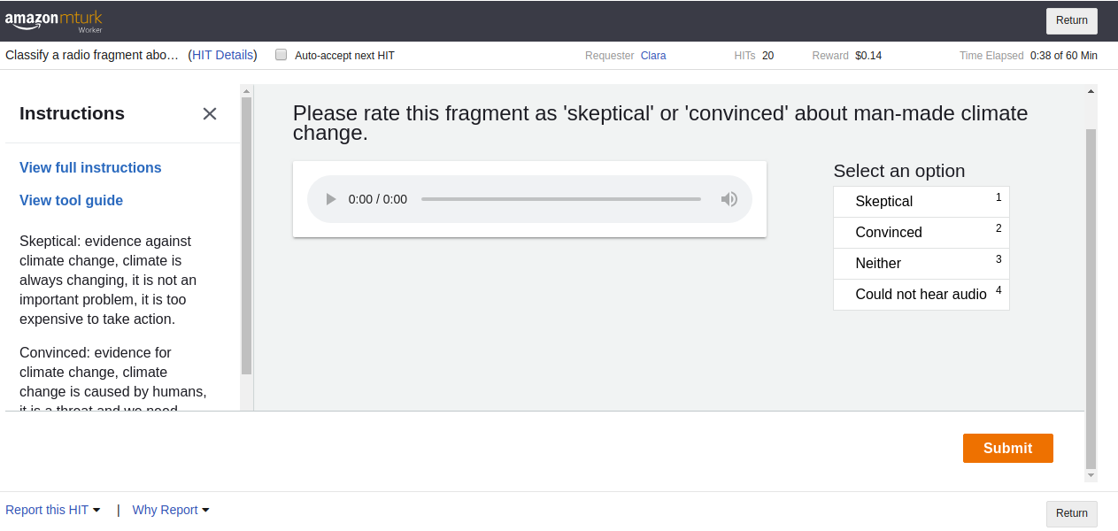
Notes:
This is audio, so there’s quite a lot of opportunity to deduce opinions not just from verbal content, but also from non-verbal cues. As you can see, there was also a little sidebar with summaries of the coding instructions on the left, and a full codebook that annotators were asked to read through before starting.

Slide 49
 | Climate change | Gun policy | Immigration
2 coders agree | 71% | 61% | 54%
2 out of 3 agree | 25% | 32% | 37%
3 coders disagree | 4% | 6% | 9%
Notes:
Note: in case of immigration, most disagreements were about whether a fragment was "neither" or took a position. The low rates were not, as far as I could tell, due to particular coders underperforming. In fact, performance in a randomly selected half of a person’s tasks was barely predictive of performance in the other half.

Slide 50
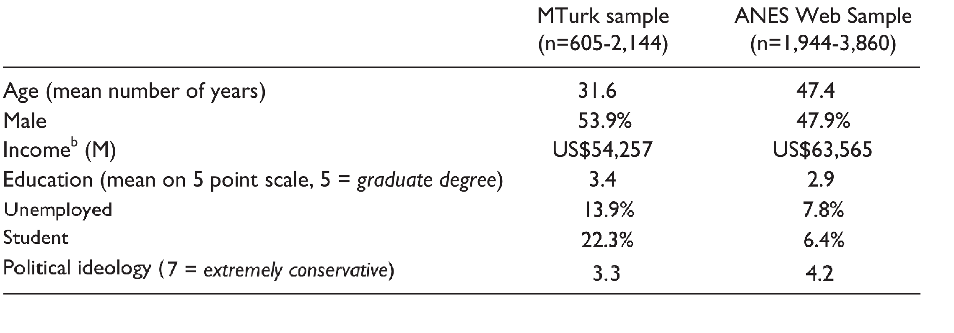
Levay, Freese & Druckman (2016)
Notes:
Of course, besides having high variance in their annotations, coders could also have bias, i.e. they could be systematically off in some predictable way. For example, their annotations might be connected to their demographics—here, we see that US Mechanical Turk workers are quite a bit younger, lower-income and higher-education than the average American. Many are students, and they are somewhat more left-wing than average.

Slide 51
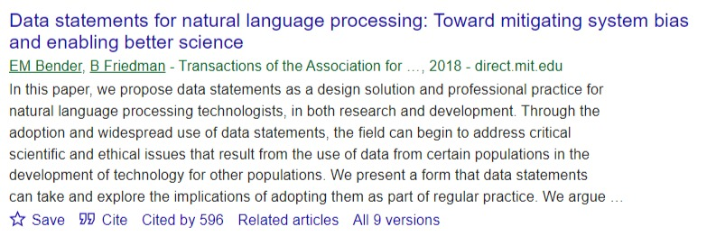
Bias and error in annotations

Slide 52
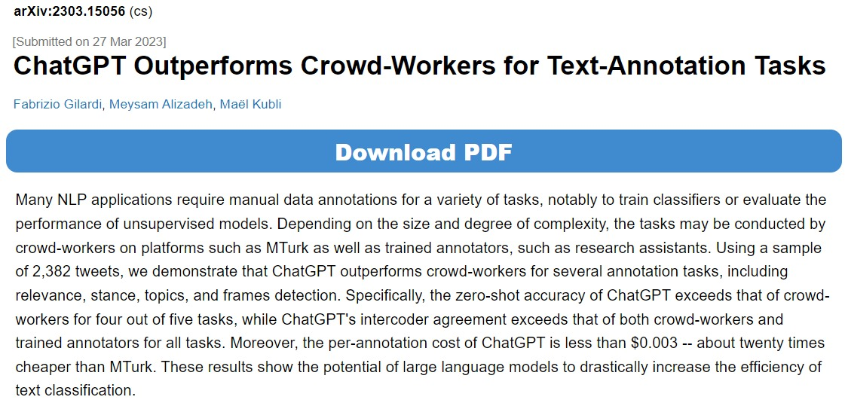

Slide 53
Next class preview

Slide 54
Two guest lectures
Images as data by Simon von der Maase
Audio as data by Mathias Rask

